Slide 1

TEST CASE
BY
SUPRAJA C
EMP ID: 6142

Slide 2
WHAT IS A TEST CASE?
A TEST CASE is a set of actions executed to verify a particular feature or functionality of your software application.
A Test Case contains test steps, test data, precondition, postcondition developed for specific test scenario to verify any requirement.
The test case includes specific variables or conditions, using which a testing engineer can compare expected and actual results to determine whether a software product is functioning as per the requirements of the customer.

Slide 3
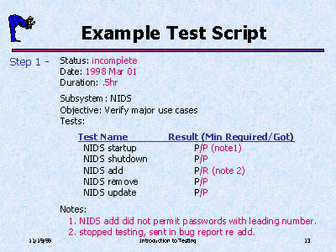
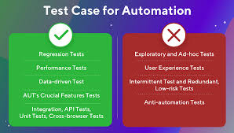
DIFFERENCE BETWEEN TEST SCRIPT & TEST CASE
A test script is a short program meant to test certain functionality.
A test case is a document with steps to be completed as planned out ahead of time.

Slide 4
8 BASIC STEPS IN TEST CASES
1.Test case ID
2.Test description
3.Assumptions & pre-conditions
4.Test data
5.Steps to be executed
6.Expected result
7.Actual result & post-conditions
8.Pass or fail

Slide 5
THANK YOU!

